Slide 1

SLAM FOR DRONES
Shashank Dammalapati (2017ME10572)
Pavan (2017ME10583)
Chaitanya Ram (2017ME10576)
Supervised by
Prof. Subir Kumar Saha
DEPARTMENT OF MECHANICAL ENGINEERING
INDIAN INSTITUTE OF TECHNOLOGY, DELHI
AUG 2020
(Project code: D-12)

Slide 2
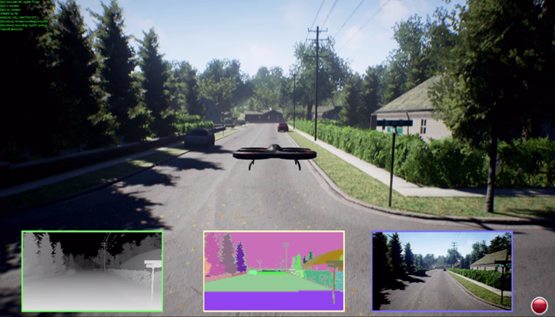
Introduction
Future of Mobility and most robot operations is Autonomous
Awareness of its environment is crucial for attaining Autonomy
We have various sensors and SLAM techniques for creating awareness to the robot
Experimenting with different sensors and in different environments in real life is both costly and time consuming
Realistic Computer Simulators like AirSim helps us with the test and develop different SLAM algorithms

Slide 3
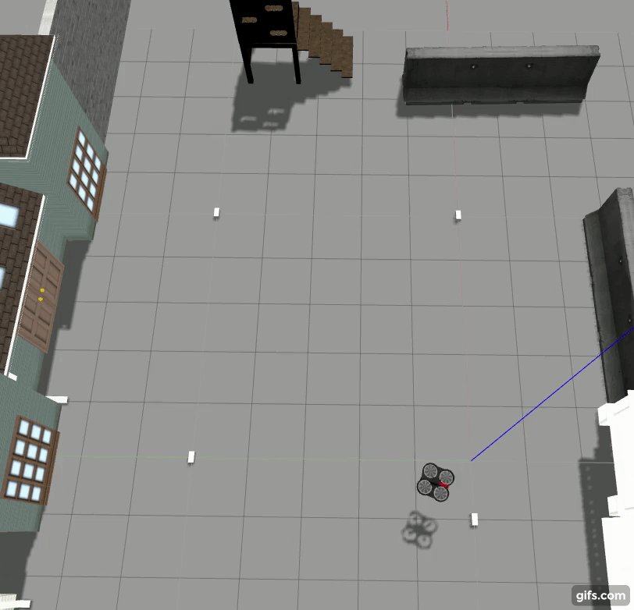
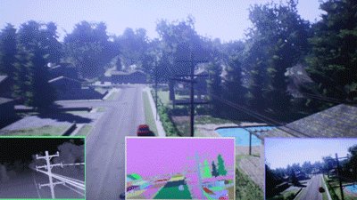
LITERATURE SURVEY _ Simulation Environments
ROS| Gazebo Simulator
Unreal Engine | AirSim

Slide 4
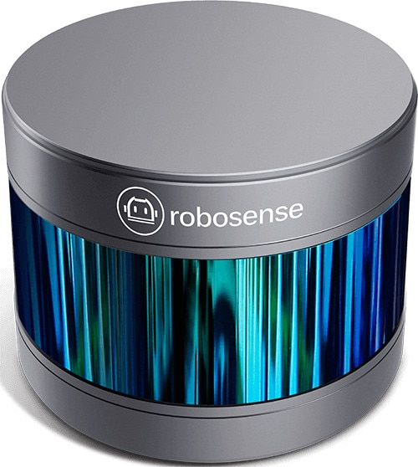
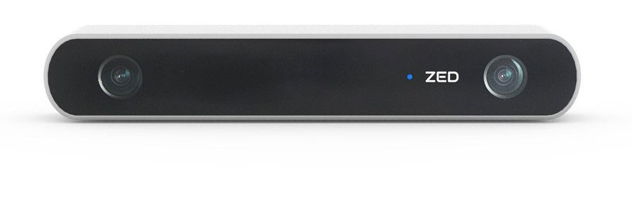
LITERATURE SURVEY Sensors
Both Vision and Lidar based sensors are absolute sensors unlike sensors like IMUs which give only Relative measurements
Vision Sensors are cheaper than LIDAR sensors
In simulations, we can use any sensor just by importing its model except we have Computational costs to manage
We are using LIDAR based sensors considering the low computational power requirements compared to Vision sensors

Slide 5

Project Objectives
Create a 3D rendering environment that emulates scene reality and physics with proper API control access to the objects in the simulation from external Python codes.
Creating an external mapping environment for plotting the point cloud data collected from the simulation
Developing LIDAR based SLAM algorithms that estimate the trajectory of the robot and create a 3D occupancy map of the environment from the 3D Lidar point clouds and previously estimated trajectory
Retesting our SLAM algorithm in multiple test environments to prove the repeatability and ease of developing SLAM algorithms first through Simulation before going to real world testing.

Slide 6
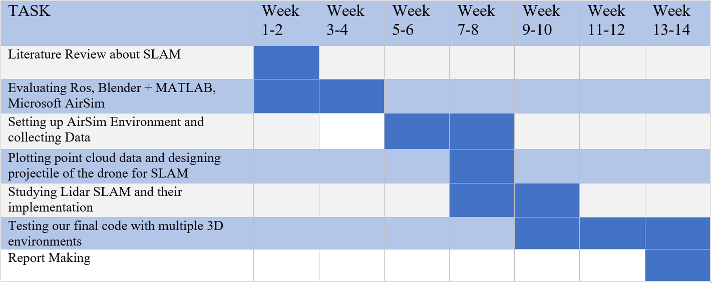
Gantt Chart
Current Situation

Slide 7
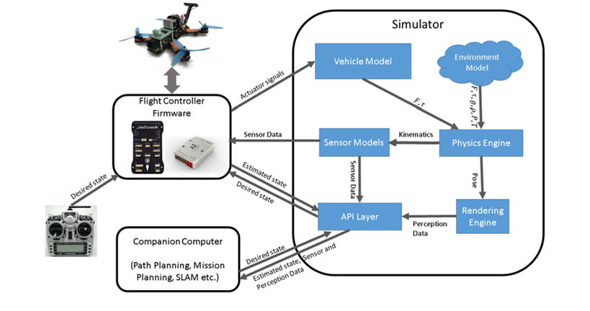
THEORY – AirSim Architecture
Unreal Engine: Microsoft’s AirSim Project Architecture

Slide 8
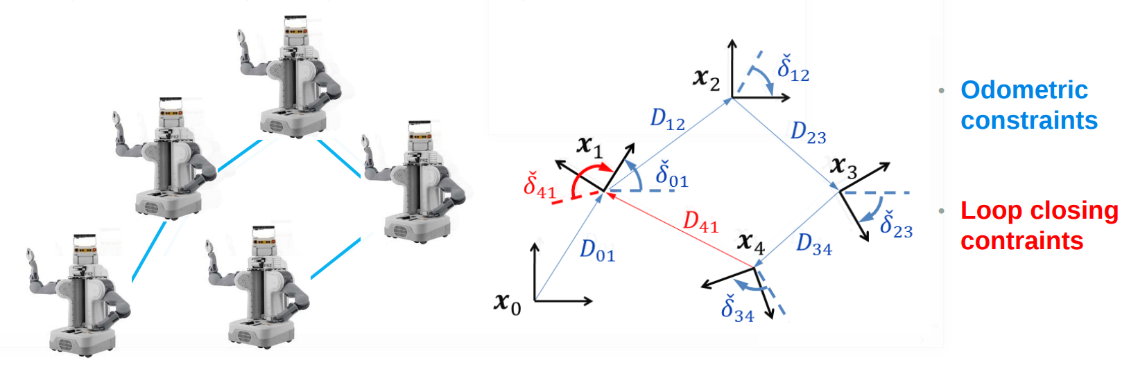
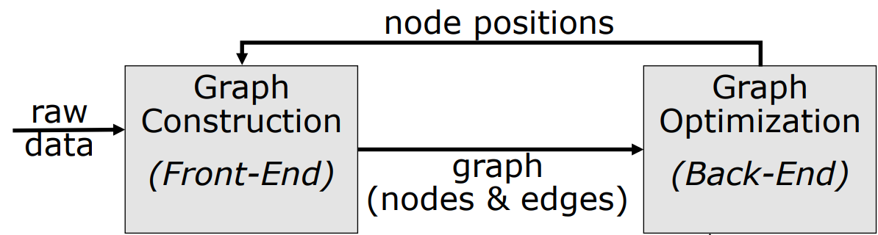
SLAM - THEORY
POSE GRAPH OPTIMIZATION
Relative Pose Measurements:
1. Self Motion (IMU)
2. Scan Matching
Mapping Data:
1. Lidar Point Cloud
The Overall SLAM System

Slide 9
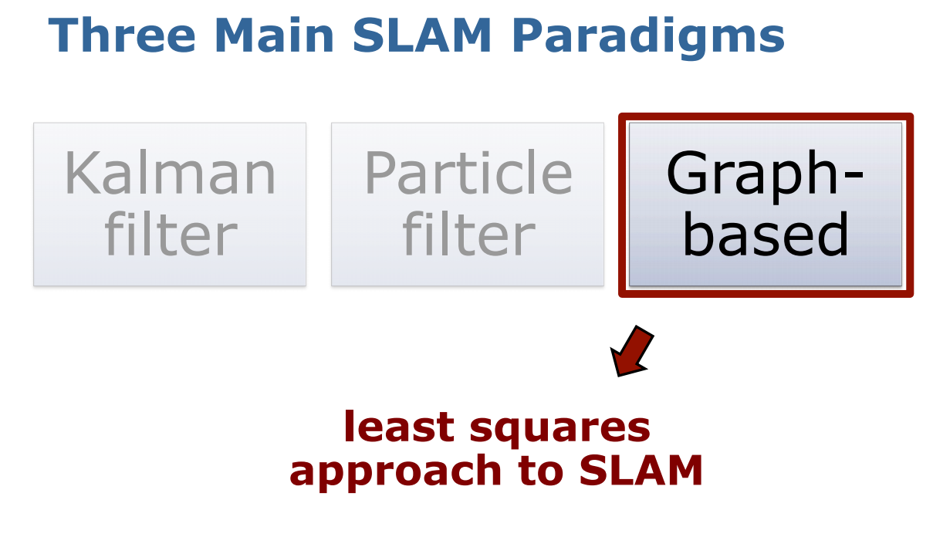
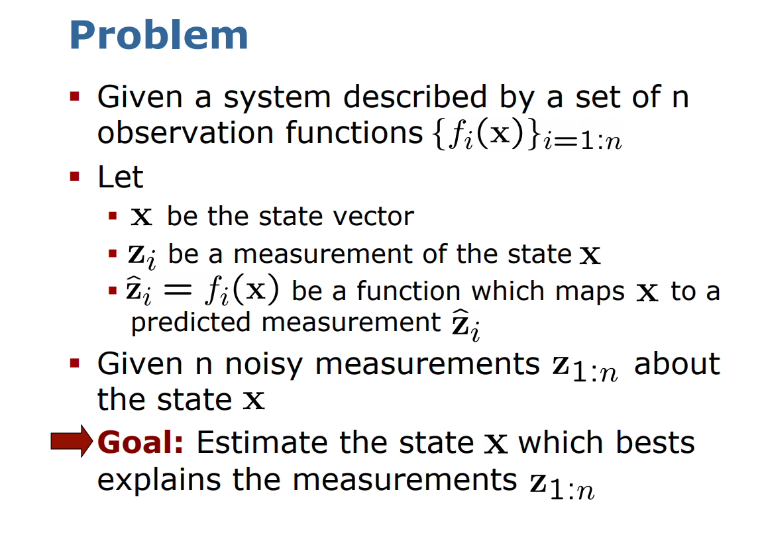
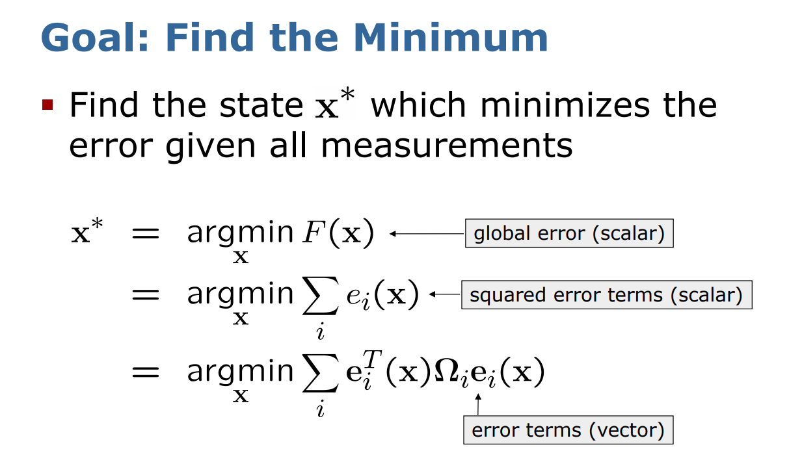
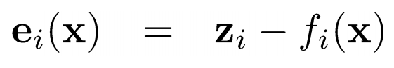

Slide 10
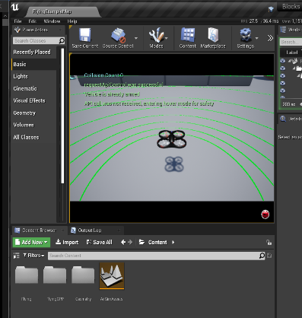
Experiment Setup
Download Unreal Engine
Build AirSim Project
Setup API control for Companion computer and the Simulation Engine
Fetch Sensor Data using API Layer as shown in the figure below.
Import Matplotlib module to Python development and use it plot the data fetched from simulated Lidar sensor from the Unreal Engine’s AirSim project environment.

Slide 11
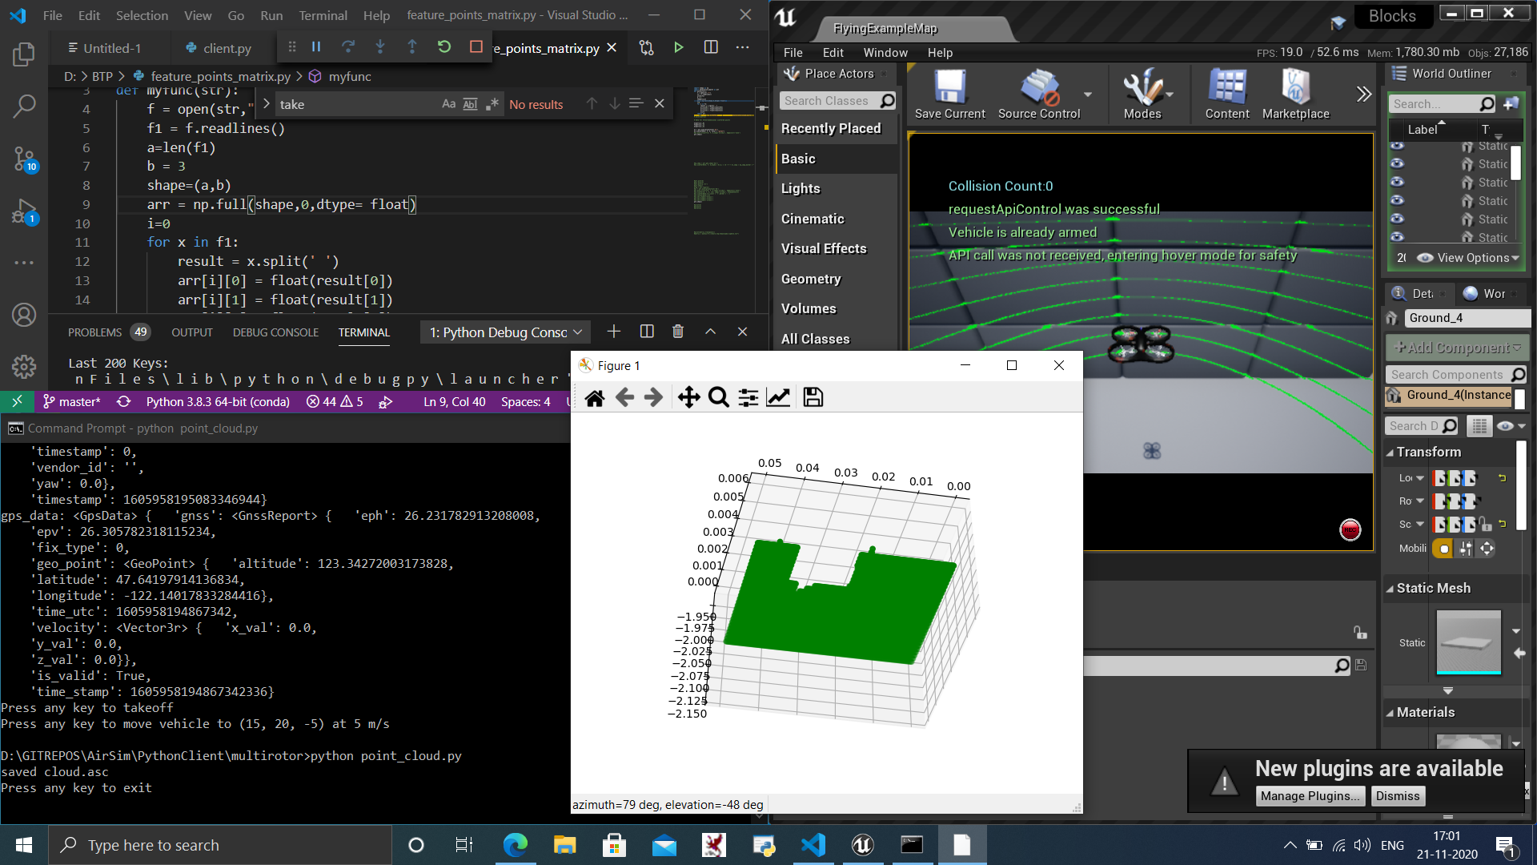
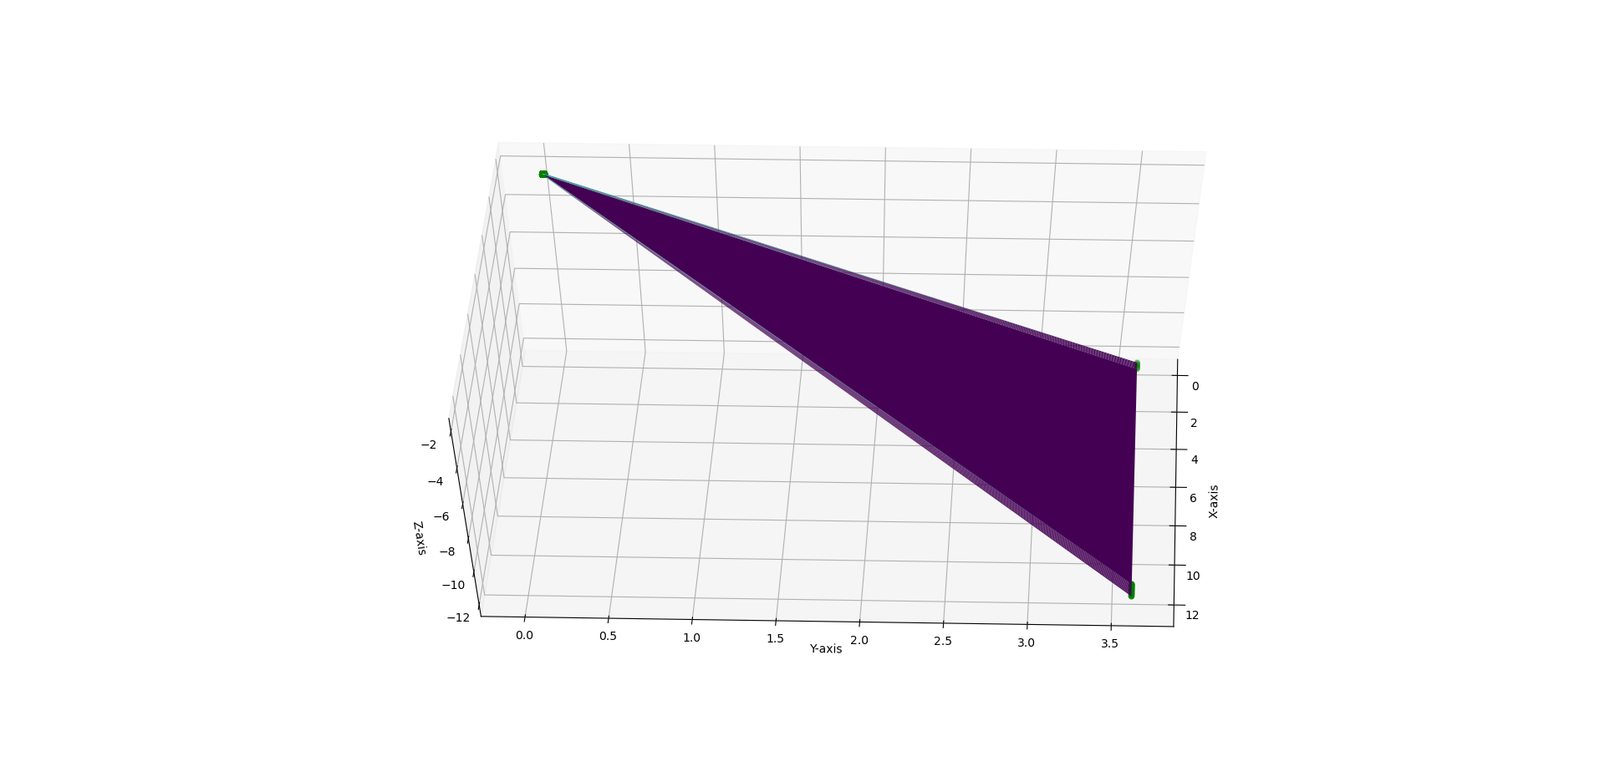
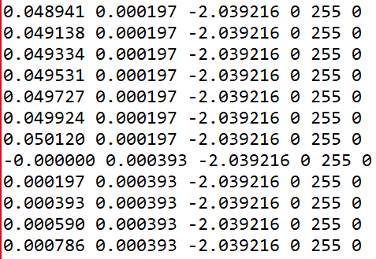
RESULT
Airsim (3D Environment) Installation – Complete
Python code of plotting 3D map from “.asc” format point cloud data is complete.
Currently, fetching of Lidar data has some issues. When we try to plot the received data as shown in the figure it is not showing expected output. We must work on properly fetching Lidar data.

Slide 12
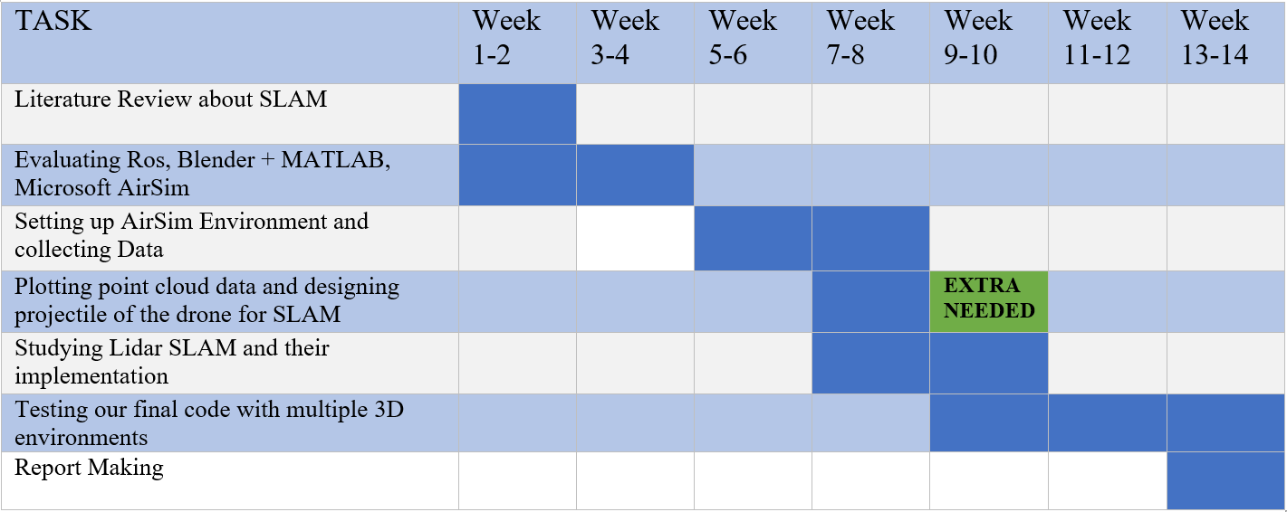
Gantt Chart _ Corrected
Current Situation

Slide 13
Conclusion
Literature Review about SLAM
Evaluating Ros, Blender + MATLAB, Microsoft AirSim
Setting up AirSim Environment and collecting Data
Setting up AirSim Environment and collecting Data
Studying Lidar SLAM and their implementation
Testing our final code with multiple 3D environments
Report Making

Slide 14


Thank You

